Slide 1

Compiler Design
Preet Kanwal
Department of Computer Science & Engineering
Teaching Assistant : Kavya P K

Slide 2

Compiler Design
Unit 1
Specification and Recognition of Tokens
Preet Kanwal
Department of Computer Science & Engineering

Slide 3
Compiler Design Lecture Overview
In this lecture, you will learn about:
Revision :
What are tokens?
Classes of tokens
Attributes
Implementation of Lexer:
Hand-written Implementation
Using a tool like: lex, PLY, CUP(in Java)
Handwritten Implementation:
Specification of Tokens
Recap - Regular expressions and Transition diagrams
Implementation of Transition Diagrams
How does the Lexical Analyzer implement all transition diagrams?
Questions

Slide 4
Compiler Design
Some important definitions
Recall that
Token :- It is a pair consisting of a token name and an optional attribute value.
<token name, attribute value>
Token name is an abstract symbol representing a kind of lexical unit - keywords, identifiers etc.
Attribute value is pointer to the symbol table entry.

Slide 5
Compiler Design Examples
Token | Informal Description of Pattern | Lexemes
if | Character i,f | If
else | Characters e,l,s,e | else
Comparison | < or > or <= or >= or == or != | <=,!=
id | Letter followed by letters and digits | Sum, avg1, pi
number | Any numeric constant | 10001, 3.14
literal | Anything but “, surrounded by “ | “compiler design”

Slide 6
Compiler Design Tokens
Tokens are required to classify substrings of source program according to their role.
The parser relies on token distinctions.
get next token is the command sent from the Parser to the Lexical analyzer.
On receipt of the command, the lexical analyzer scans the input until it determines the next token, and returns it.
Input is read left to right.
Lookahead is required to decide where one token ends.

Slide 7
Compiler Design Classes of Tokens
Choosing good tokens is important, and is mostly language specific. The most common classes of tokens are listed below:
Keywords - One token for each keyword. The pattern for a keyword is the same as the keyword itself.
Operators - Tokens either individually, or in classes for operators.
Identifiers - One token representing all identifiers.
Constants - One or more tokens representing constants, such as numbers and literal strings.
Punctuation Symbols - Tokens for each punctuation symbol, such as left and right parentheses, comma and semicolon.

Slide 8
Compiler Design Attributes of Tokens
When more than one lexeme can match a pattern, lexical analyzer must provide additional information about each lexeme matched.
This additional information is stored in the attribute-value field of the token.
The attribute-value field can include several pieces of information.
Consider the example : token ID (an identifier)
Its attributes are the lexeme, the type and the location at which it is first found. This is added to the symbol table.
The attribute value is the pointer to the symbol table entry for that identifier.
Lexical analyzer returns token name and attribute value to parser.
The token name influences parsing decisions, whereas the attribute value influences translation of tokens after parsing.

Slide 9
Compiler Design Implementation of Lexer
There are two ways :
Hand-written Implementation : One will write the lexer from scratch as a program. For example : The C compiler is hand-written. It is basically called loop-switch implementation.
Using a tool : lex, PLY

Slide 10
Compiler Design Implementation of Lexer
Hand-written Implementation

Slide 11
Compiler Design Specification of Tokens
The specification of tokens is done using formal notations, i.e, regular expressions.
Some important definitions -
Symbol : A letter, digit or punctuation
Alphabet : A finite set of symbols, for e.g, {0,1} is a Binary alphabet
String over an alphabet : A finite set of symbols drawn from the alphabet
If s is the string, then |s| denotes the length of the string
Language - A set of strings over a fixed alphabet
Abstract language - An empty set, {e}

Slide 12
Compiler Design
Recap - Regular Expressions
Regular expressions are special text strings that describe a search pattern.
It is mainly used for pattern matching.
It is a metalanguage - a form of language used for description or analysis of another language.
It uses metacharacters - characters that have special meaning. For eg -
* matches any number of characters
. matches single characters except newline
\ drops the special meaning of the next character
A Regular language is a formal language that can be expressed using a regular expression.
Regular expressions are the grammatical notations used for describing structure of tokens, i.e, patterns.

Slide 13
Compiler Design Regular Definitions
For notational convenience, names can be given to regular expressions, and these names can be used to define other regular expressions.
This is called a regular definition.
Example 1 : Regular definition for Identifiers letter -> [a-zA-Z_]
digit -> [0-9]
id -> letter(letter|digit)*
Example 2: Regular definition for whitespace blank -> “ “
tab -> \t newline -> \n
ws -> (blank|tab|newline)+

Slide 14
Compiler Design
Recap : Transition Diagrams
Patterns are converted to stylized flowcharts called Transition Diagrams to understand how a pattern traverses a given input.
Transition diagrams consist of a collection of nodes called states.
Each state represents a condition that summarises the characters seen.
Two types of states -
1. Final or Acception State
Indicates that a lexeme has been found.
An action is attached to this state - returning the token and attribute value to the parser.
If necessary to retract the forward pointer by one position, a * is placed next to the state.
*
2. Start State

Slide 15
Compiler Design
Implementing Transition Diagrams
A variable state holds current state number
A switch based on the value of state executes the code for that state.
The following functions are used -
getc() or nextChar() - reads the next character from input.
install_id() - places the lexeme (identifier) in the symbol table if it’s not present and returns a pointer to the same.
install_num() - similar to install_id(), enters the number in the table of numbers if not present, and returns a pointer to the same.
retract() - If the accepting state has a * , this function is used to retract forward pointer.

Slide 16
Compiler Design
Implementing Transition Diagrams
getToken() - examines the symbol table entry for the lexeme found and returns the corresponding token name.
fail() - resets forward ptr to lexeme_begin to try another transition diagram.
What the fail() function does depends on the global error recovery strategy of the Lexical Analyzer
isalpha(c) - returns true iff c is an alphabet
isdigit(c) - returns true iff c is a digit
isalnum(c) - returns true iff c is an alphabet/digit
isdelim(c) - returns true iff c is a delimiter

Slide 17
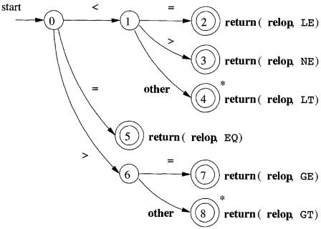
Compiler Design
Transition Diagram for Relational operators
Regular Expression -
relop < | < = | > | > = | <> | ==

Slide 18
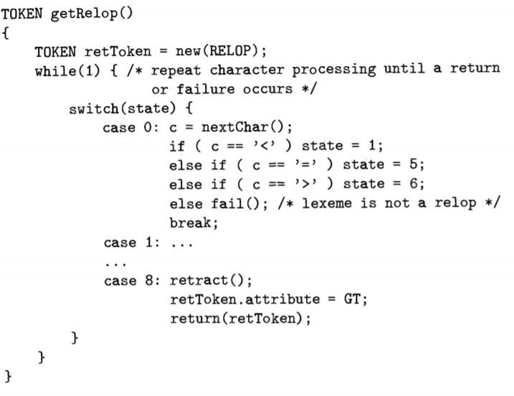
Compiler Design
Implementation - Relational Operators

Slide 19
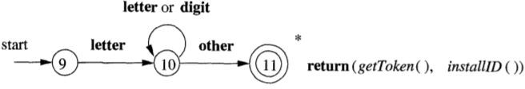
Compiler Design
Transition Diagram for Identifiers
Regular Expression -
letter [a-zA-Z] digit [0-9]
letter ([letter|digit] | ”_”)*

Slide 20
Compiler Design Implementation for Identifiers
For pseudo-code, please refer to the file: identifier_loopswitch_pseudocode.c.txt
Note: This file is only a conversion of the transition diagram from the previous slide and is not executable without a proper interface and implementations of other functions like retract(), fail(), nextChar(), etc.

Slide 21
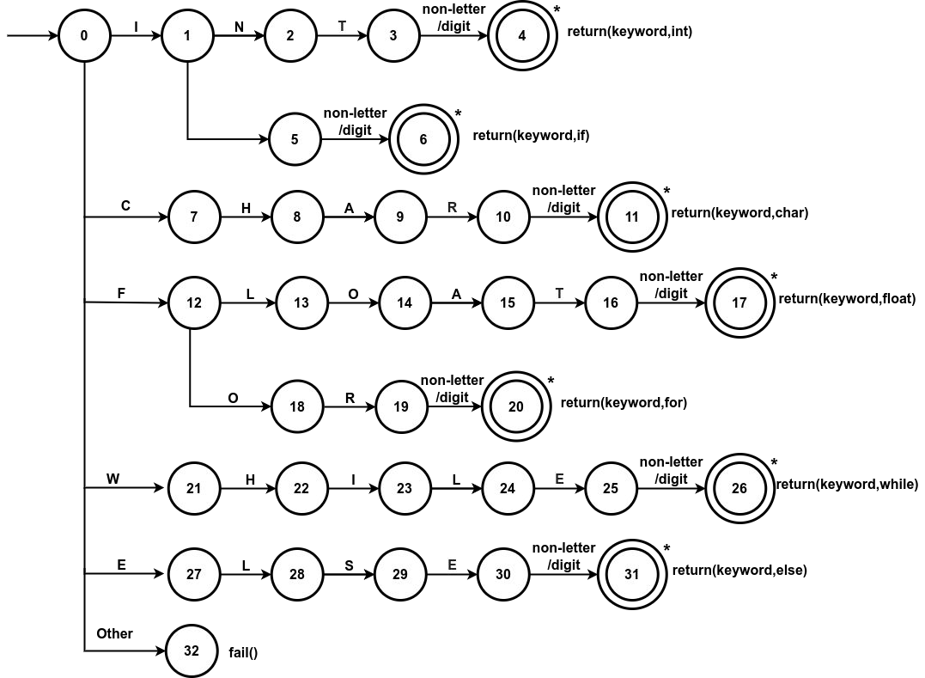

Compiler Design
Transition Diagram for Keywords
int | char | float | if | while | else | for
non-letter/digit simply means that the transition should be over a non-letter, non-digit character

Slide 22
Compiler Design Implementation for Keywords
For pseudo-code, please refer to the file: keyword_loopswitch_pseudocode.c
Note: This file is only a conversion of the transition diagram from the previous slide and is not executable without a proper interface and implementations of other functions like retract(), fail(), nextChar(), etc.
For code that combines identification of keywords and identifiers, please refer to the file:
loopswitch.c
This code is an altered version of the code from: https://gist.github.com/luckyshq/6749155

Slide 23

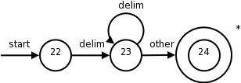
Compiler Design
Transition Diagram for Whitespaces
Regular Expression -
blank “ “
tab “\t” newline “\n”
Here, the input is retracted to begin at a non-whitespace
ws -> (blank | tab | newline)+
There is no return to parser.
The process of lexical analysis is restarted after whitespace

Slide 24
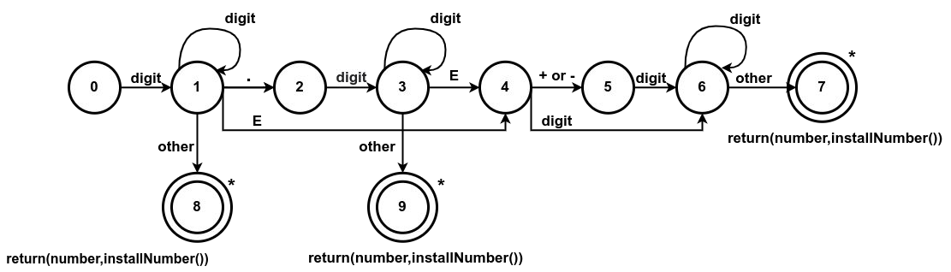
Compiler Design
Transition Diagram for Unsigned numbers
Regular Expression -
digit [0-9]+
number digit(.digit)?(E[+-]? digit)?

Slide 25
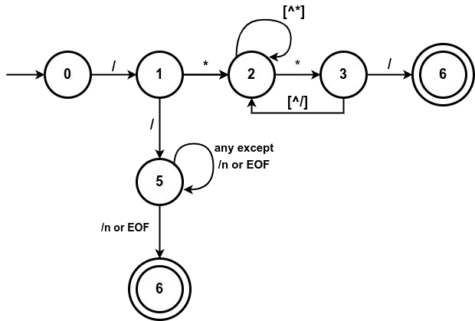
Compiler Design
Transition Diagram for Single and Multi-Line Comments in C
Regular Expression -
single-line comments: \/\/(.*) multiline comments: \/\*(.*\n)*.*\*\/

Slide 26
Compiler Design
Keywords vs Identifiers - How does the lexer handle keywords?
The transition diagram for identifiers will also recognise Keywords.
There are two ways to handle keywords that look like identifiers -
Install the reserved words in the symbol table beforehand.
One field of the symbol table entry can indicate that these are reserved words (e.g. token_name = keyword)
Thus, when an identifier is found
installID() is called to place the identifier in the symbol table.
Since keywords were preloaded in the symbol table, installID() returns the pointer to the keyword found.
getToken() can be used to return the token_name

Slide 27
Compiler Design
Keywords vs Identifiers - How does the lexer handle keywords?
Create a separate transition diagram for each keyword.
In this approach, each pattern for the keywords should be defined before the pattern for identifiers.
This enables reserved word tokens to be recognised when the lexeme matches both patterns.

Slide 28
Compiler Design
How does the Lexical Analyzer implement all transition diagrams?
There are three possible approaches -
Approach 1 - Arrange transition diagrams for each token to be tried sequentially.
Approach 2 - Run various transition diagrams in parallel
Approach 3 - Combine all transition diagrams into one.

Slide 29
Compiler Design
How does the Lexical Analyzer implement all transition diagrams?
Approach 1 - Arrange transition diagrams for each token to be tried sequentially.
In this case, each time the function fail() is called, it resets the forward pointer to lexeme_begin, and then tries the next transition diagram.
In this method, each keyword can have it’s own transition diagram, but it must be defined before the transition diagram for identifiers.

Slide 30
Compiler Design
How does the Lexical Analyzer implement all transition diagrams?
Approach 2 - Run various transition diagrams in parallel
This involves feeding the net input character to all transition diagrams
If more than one transition diagram matches the lexeme, the usual strategy is to take the longest prefix.
Approach 3 - Combine all transition diagrams into one.
The transition diagram reads input until there is no possible next state.
The longest lexeme that matches a pattern is taken.
This is the preferred approach. However, the problem of combining several transition diagrams is more complex.

Slide 31
Compiler Design
Question 1: Find the number of tokens
int a = 20;
Tokens |  | Count
int | keyword | 1
a | Identifier | 1
= | Operator | 1
20 | Constant | 1
; | Special Symbol | 1
Total |  | 5

Slide 32
Compiler Design
Question 2: Find the number of tokens
Tokens |  | Count
int main | Keyword | 2
() | Special symbol | 2
{ | Special symbol | 1
//Compiler Design | Comment | 0
int | Keyword | 1
a | Identifier | 1
, | Separator | 1
b; | Identifier, symbol | 2
a=10; | … | 4
b=10; | … | 4
return 0; | .. | 3
} | Special symbol | 1
Total |  | 22
int main()
{
//Compiler Design int a, b;
a = 10;
b = 20;
return 0;
}

Slide 33
COMPILER DESIGN
Question 3: Write the tokens and associated attribute
E = M * C ** 2
<id, Pointer to symbol table entry for E >
<assign_op>
<id , Pointer to symbol table entry for M>
<mult-op>
<id, Pointer to symbol table entry for C>
<exp-op>
<number, integer value 2>

Slide 34
COMPILER DESIGN
Question 4: List all the tokens in the following code snippet
Pattern | Lexemes
Keyword | if, else
Identifier | a, b
Relop | >
Assignop | =
Arithop | +
Number | 1
Punctuation | ( ) | { | ; | } | { | ; | }
Number | 0
if(a > b)
{
a = a + 1;
}
else
{
b = b + 1;
}

Slide 35
COMPILER DESIGN
Question 4: List all the tokens in the following code snippet
< keyword, if >
< punctuation, ( >
<identifier, a >
< relop, > >
< identifier, b >
< punctuation,) >
< punctuation, { >
<identifier, a>
< Assignop, = >
<identifier, a>
< Arithop, + >
< number, 1 >
< punctuation, ; >
< punctuation, } >
< keyword, else >
< punctuation, { >
<identifier, b>
< Assignop, = >
<identifier, b>
< Arithop, + >
< number, 1 >
< punctuation, ; >
< punctuation, } >
if(a > b)
{
a = a + 1;
}
else
{
b = b + 1;
}

Slide 36
THANK YOU
Preet Kanwal
Department of Computer Science & Engineering
preetkanwal@pes.edu

